Slide 1



SPEECH-TO-TEXT + SUMMARIZER APPLICATION
Convert Speech to Text and Summarize Automatically using AI
Presented by :- Varun Kumar
Email Id :- varungupta0994@gmail.com
Institute :- Bakhtiyarpur College of Engineering
Department :- Computer Science And Engineering
Internship :- Infosys Internship Program
Duration :- 2 Months
Project Guide :- Prathap Reddy
page 01

Slide 2

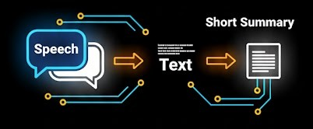
Introduction
Objective: To build an AI-powered application that can convert human speech into text and generate summarized content automatically.
Key Features:
Converts audio (file/recording) into text
Generates summary using NLP
Supports multiple audio formats
Clean and denoised audio processing
User-friendly interface
page 02

Slide 3
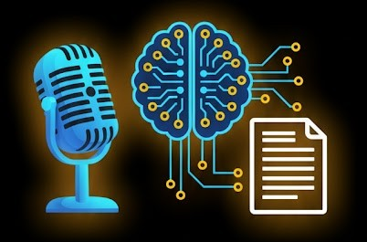

Motivation
Why this project?
Manual transcription is time-consuming
Large audio files are hard to understand quickly
AI can automate both transcription and summarization
Useful for lectures, meetings, and interviews
page 03

Slide 4

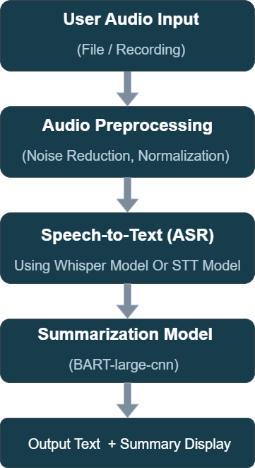
System Architecture (Flow Chart)
page 04

Slide 5

Flask (Python)
Transformers (Hugging Face)
Librosa, SoundFile, Pydub, Noisereduce
Flask (Python)
Transformers (Hugging Face)
Librosa, SoundFile, Pydub, Noisereduce
Technology Stack
Backend:
Frontend:
Models Used:
Flask (Python)
Transformers (Hugging Face)
Librosa, SoundFile, Pydub, Noisereduce
React.js
Axios
HTML, CSS
Speech Recognition: openai/whisper-small
Summarization: facebook/bart-large-cnn
page 05

Slide 6
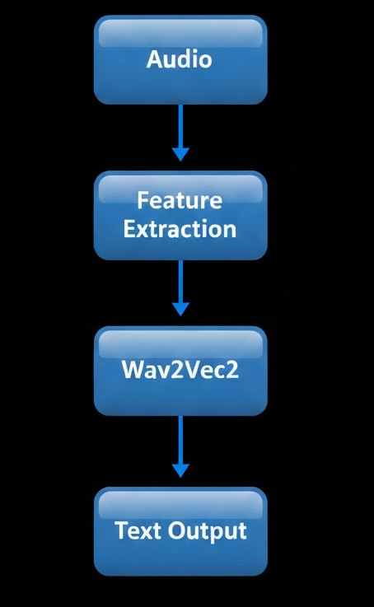
Speech-to-Text Model (STT-Model)
Developed by: Varun Kumar
Fine-tuned Wav2Vec2 model for accurate transcription (Fine-tuned link: click here)
Trained using open datasets (dataset link: click here)
Used Google Drive for model path storage (model link: click here)
Optimized for Hindi + English (Indian accent)
page 06
🧠 Note:
Training STT models from scratch needs 1000+ hours of data, so a fine-tuning approach was used for faster convergence.

Slide 7
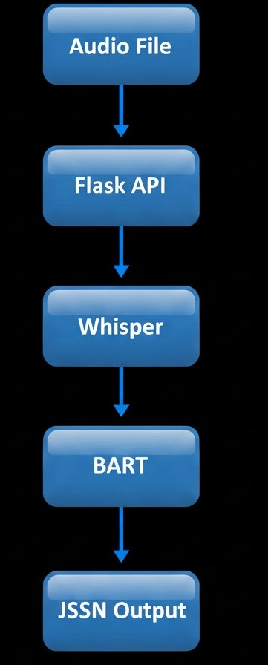
Backend Architecture
Framework: Flask Endpoints:
/stt → Speech to text + summarization
/save → Save output file
Modules Used:
Librosa: for audio normalization
noisereduce: for denoising
Transformers: for AI model inference
Soundfile: for saving cleaned audio
page 07

Slide 8
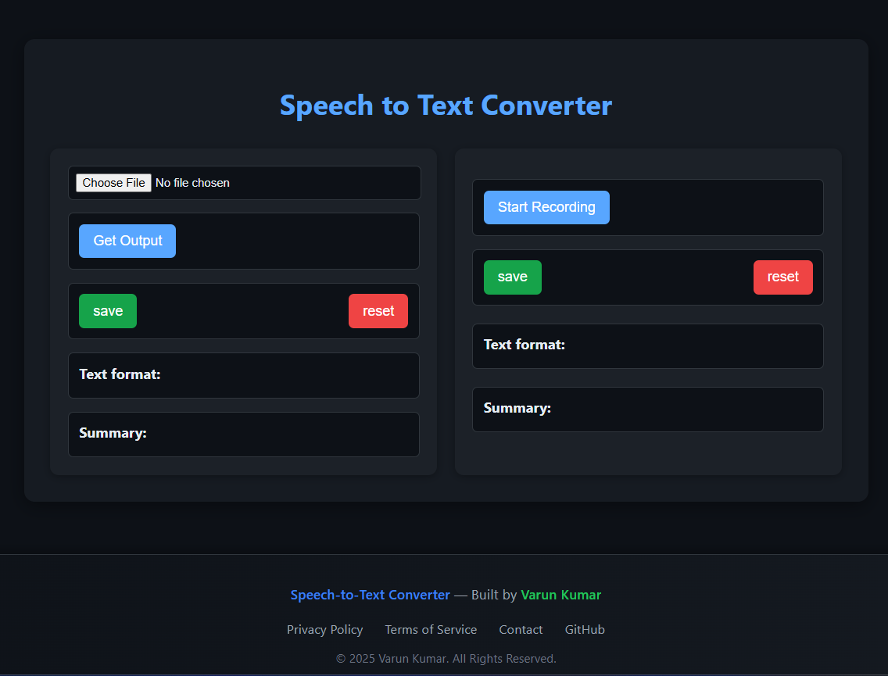
Frontend Interface
Framework: React.js Features:
File upload or direct recording
Display transcribed text and summary
Save results
Responsive and minimal UI
page 08

Slide 9
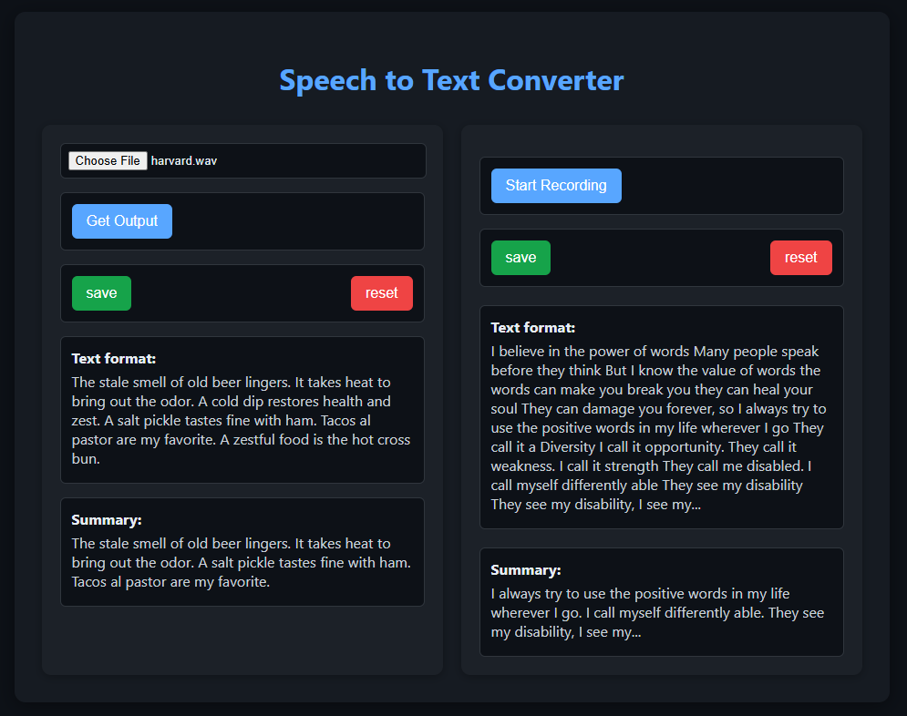
Output Screenshots
Output Display Page:
page 09

Slide 10
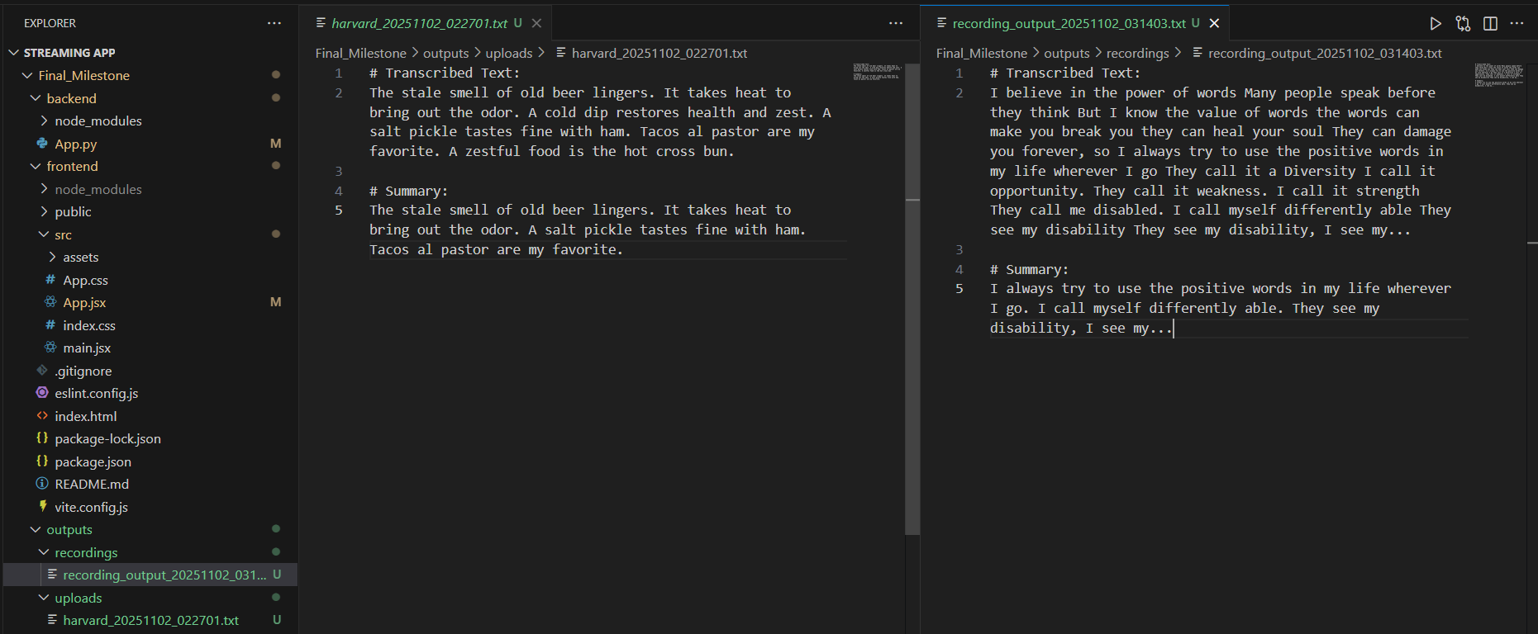
Output Screenshots
Saved Output Files And Project Structure:
page 10

Slide 11
Results and Performance
Accuracy:
Whisper (pretrained) achieved high transcription accuracy
Summarizer reduced text length by ~60–70% while keeping meaning
Output Example:
Original Transcript: 120 words Summary: 40 words
page 11

Slide 12
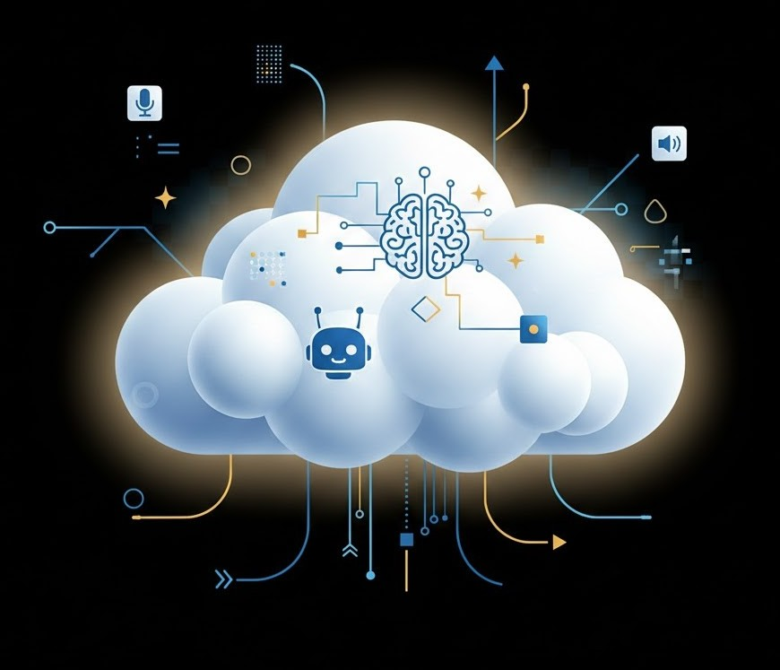
Future Enhancements
✅ Add real-time streaming transcription ✅ Multi-language summarization ✅ User authentication and history tracking ✅ Deploy on cloud (AWS / Render)
page 12

Slide 13

Model loading time due to large size
Handling noise in real audio
RAM usage during model inference
Integration between Flask and React
Challenges Faced
Model loading time due to large size
Handling noise in real audio
RAM usage during model inference
Integration between Flask and React
page 13

Slide 14

Conclusion
Successfully built an AI-powered Speech-to-Text + Summarizer app
Combines audio processing + NLP seamlessly
Helps users save time and effort in generating summaries
page 14

Slide 15
References
Hugging Face Transformers Library
OpenAI Whisper Model
Facebook BART Large CNN
Librosa Audio Toolkit
Flask Documentation
page 15

Slide 16
THANK YOU!
page 16

